Slide 1
Grading at Tumwater
MYP Rubrics
Four Rubrics in each Subject
8 Point Scale
Summary Judgments
All work within a standard
Aggregation method can vary by teacher
Letter Grade Conversion

Slide 2
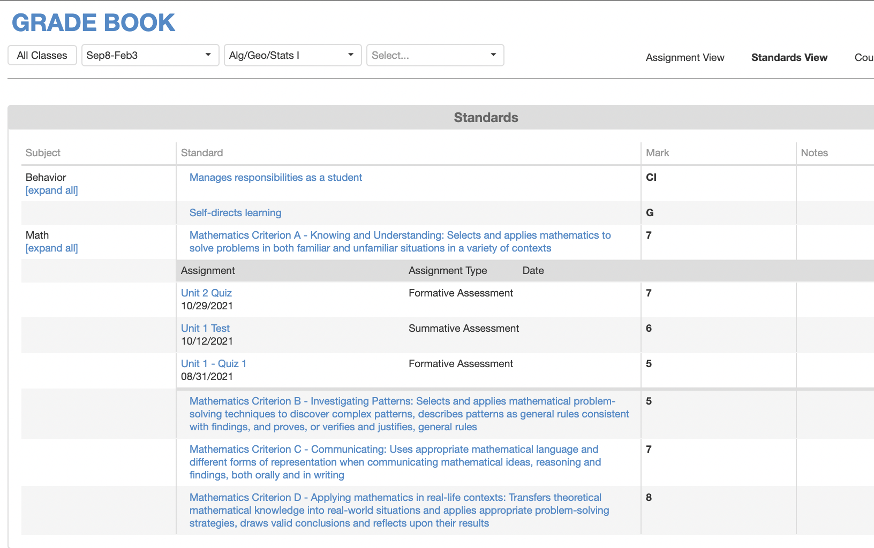
ParentVue/StudentVue
Not “How can I get an “A”?
But
How can I improve in criterion A?

Slide 3
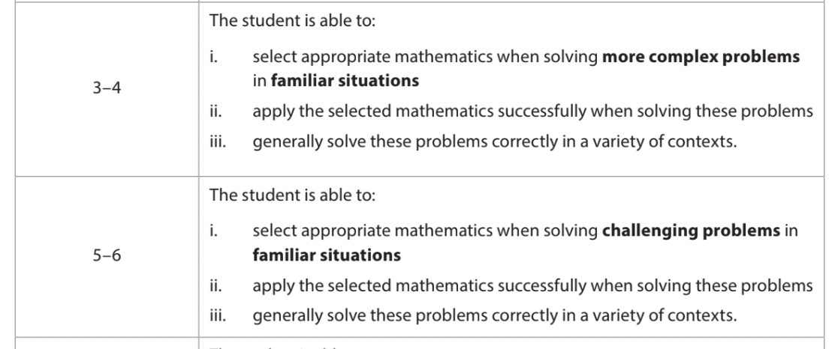

Slide 4
