Slide 1
How to Teach
The Stock Market Game
in Your Remote/Hybrid Classroom
Presentation + Q&A Session
Carolyn Quest,
DECA Stock Market Game Coordinator

Slide 2
Overview
DECA Stock Market Game run down (10 mins)
Overview of the competition, rules, important dates & ICDC qualification
SIFMA Foundation resources (10 mins)
Teacher Support Center, Google Classroom, YouTube, Stock Market Game Teachers Facebook Group
& NEW hybrid/remote learning resources coming this fall!
Q & A (5-10 mins)
Ask away!

Slide 3
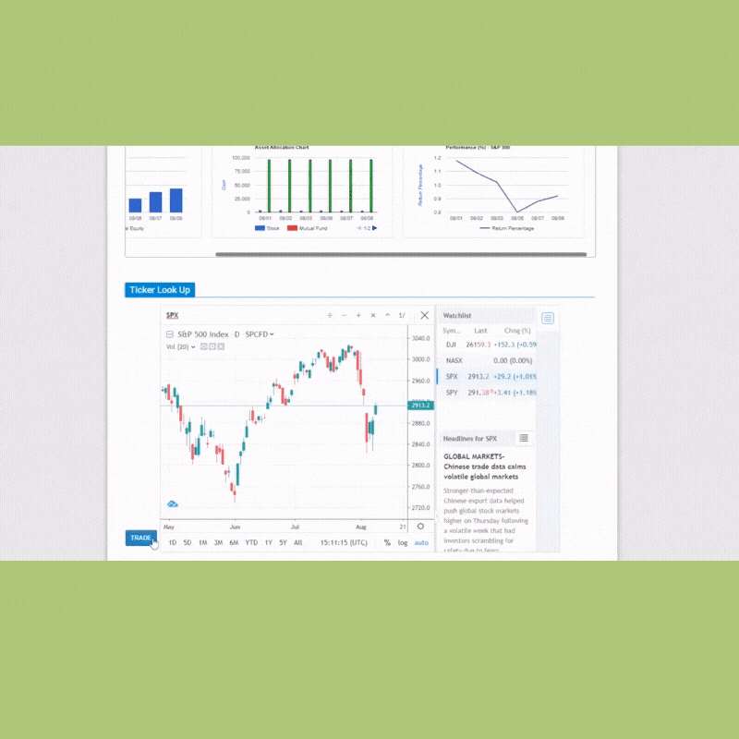
DECA
Stock Market Game (SMG)
Develop & manage $100,000 virtual investment portfolio – stocks, bonds & mutual funds.
Completely online
21st century skills – critical thinking, communication, collaboration & creativity
Financially independent futures
Register: http://deca.smgww.org/#/

Slide 4
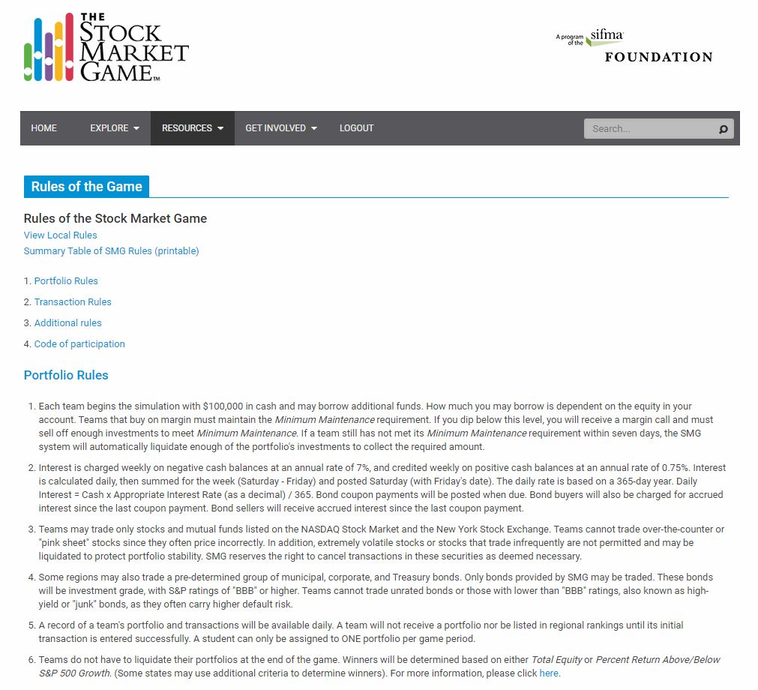
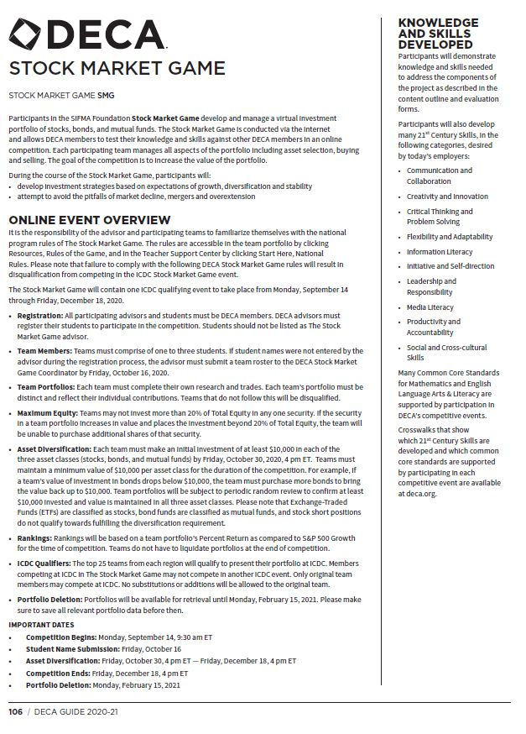
SMG National Rules & DECA SMG Rules
Know both!

Slide 5
DECA SMG Rules
View here: https://www.deca.org/wp-content/uploads/2020/06/HS_SMG_Guidelines.pdf
1-3 DECA students per team
20% Maximum Equity- cannot invest more than 20% of Total Equity in any one security (automatically system enforced)
Asset Diversification- invest $10,000 in each of the 3 asset classes (stocks, bonds & mutual funds) by deadline & maintain for the duration of the competition
Ex: If a team’s value of investment in bonds drops below $10,000, the team must purchase more bonds to bring the value back up to $10,000.
Distinct portfolios
Periodic portfolio checks
Disqualification ☹

Slide 6
Important Dates
Competition Begins: Monday, September 14, 9:30 am ET
Student Name Submission: Friday, October 16
Asset Diversification: Friday, October 30, 4 pm ET — Friday, December 18, 4 pm ET
Competition Ends: Friday, December 18, 4 pm ET
Portfolio Deletion: Monday, February 15, 2021

Slide 7
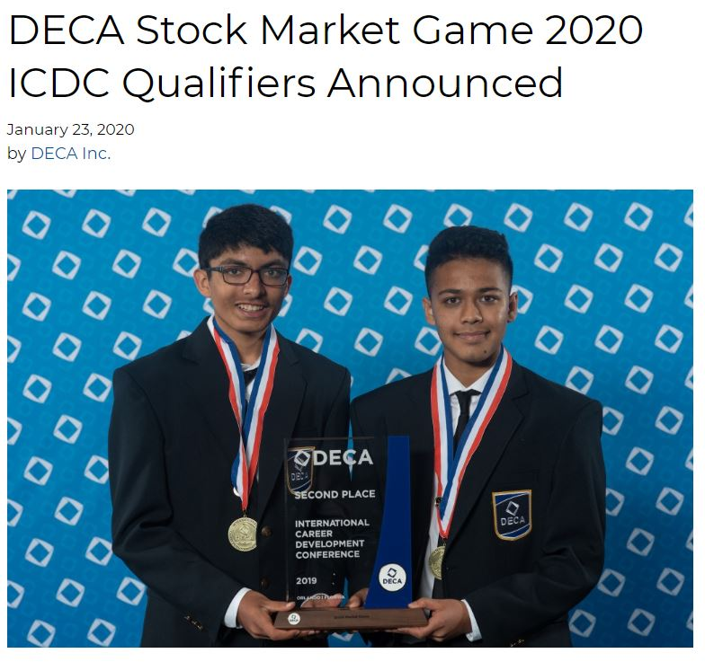
ICDC
Ranking- portfolio’s Percent Return as compared to S&P 500 Growth during competition
The top 25 teams from each region will qualify
*if followed all SMG National & DECA SMG rules
Written document describing the investment project (10 pages max)
Oral presentation (15 mins max)
Panel of judges will evaluate the presentation

Slide 8
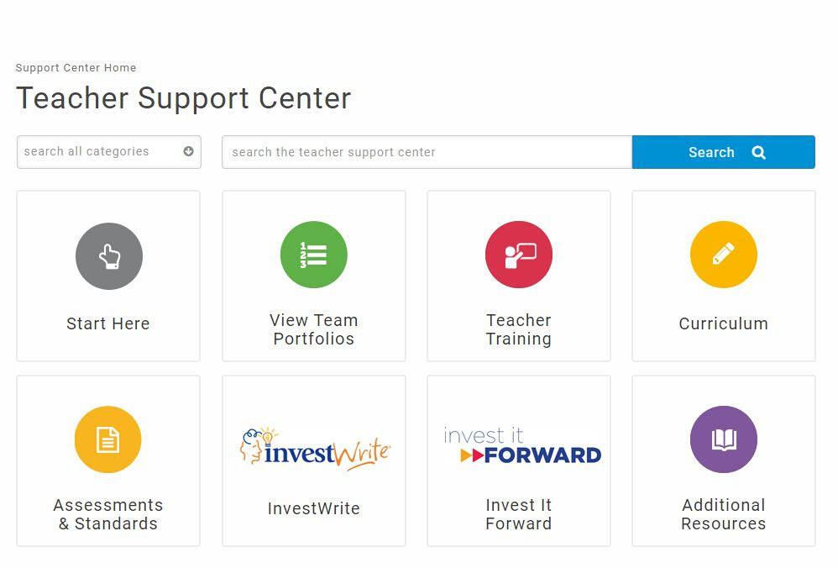
Teacher Support Center
(TSC)
Warehouse! Houses all our curriculum & supporting resources
Visit: www.stockmarketgame.org Log in with advisor ID/password
Start Here- national webinars, training videos, rules, core lessons
Curriculum- filter by grade

Slide 9
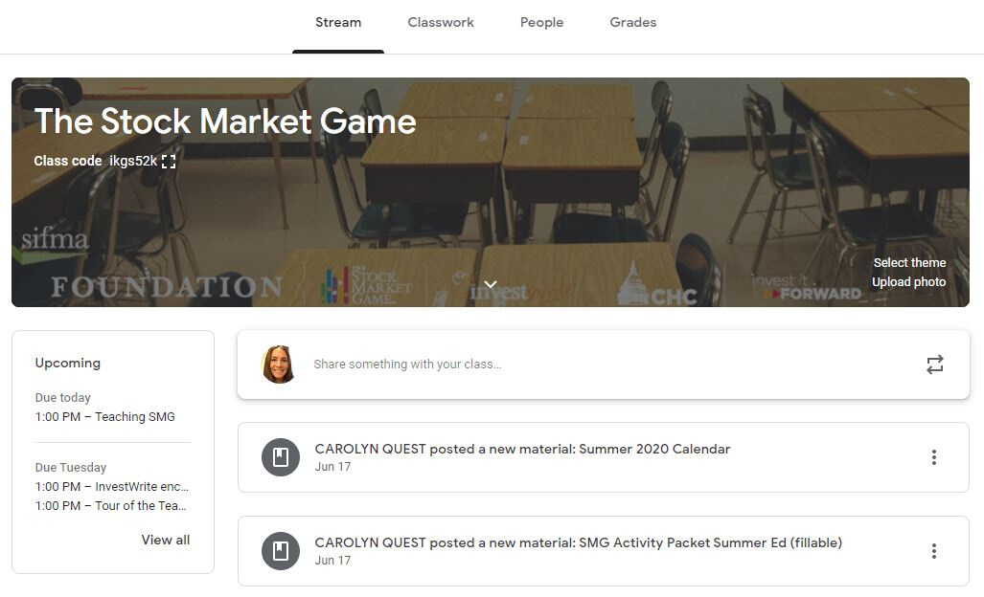
Google Classroom
Class code: ikgs52k
Storefront! Selection of our updated remote/hybrid learning resources
SMG Student Activity Packet
Pacing Calendar
Webinars- teachers & students! (national)

Slide 10
YouTube
Hosts our tutorial videos & recorded webinars
Search for: The Stock Market Game Program
https://www.youtube.com/c/thestockmarketgameprogram
Training Videos: Portfolio Overview, Research & Entering Trades
Student Webinars Playlist: Bear Market Investing, Dividend Stocks, Bonds, etc.

Slide 11
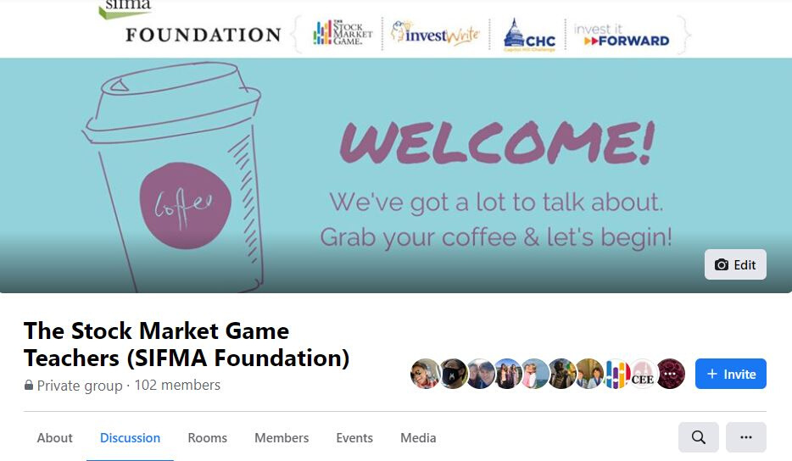
SMG Teachers
Facebook Group
Connects educators nationwide
https://www.facebook.com/groups/stockmarketgameteachers
Connect
Ask questions
Share resources

Slide 12
Coming Soon!
Video lessons of core concepts for asynchronous learning
(10 videos, 3-5 mins each)
SIFMA Foundation Weekly starting September 21!

Slide 13
Thank you!
Let me know if you have questions!
Carolyn Quest
cquest@sifma.org

